Slide 1
Introduction to Touchpoint Curriculum
TC
1

Slide 2
Agenda
What are Touchpoints?
Why do we have Touchpoint Curriculum? (NDAA & DoDi)
Learning Objectives
CG Touchpoint Process
Training Completion Options
Touchpoint Examples
Resources

Slide 3
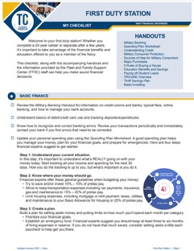
Why Do We Have Touchpoint Curriculum?
Each phase of a military career comes with new milestones and important financial considerations. We call these life milestones “Touchpoints.”
The DoD & CG developed quick informational videos, checklists, and resources to help navigate through these important “Touchpoints.”

Slide 4
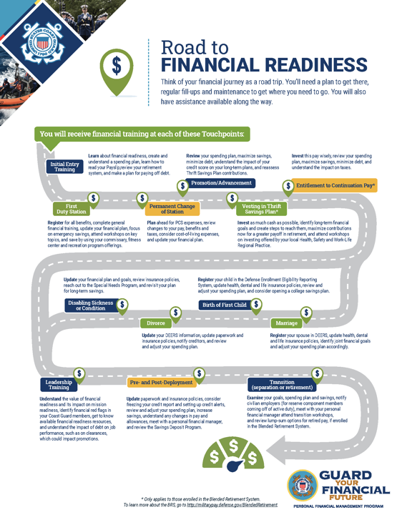

What Are the Touchpoints?
Initial Entry Training
First Duty Station
PCS Moves
Promotion/Advancement
Vesting in the TSP
Entitlement to Continuation Pay
Disabling Condition
Divorce
Birth and Adoption
Marriage
Leadership Training
Pre- and Post-Deployment
Career Transition
Road to Financial Readiness

Slide 5
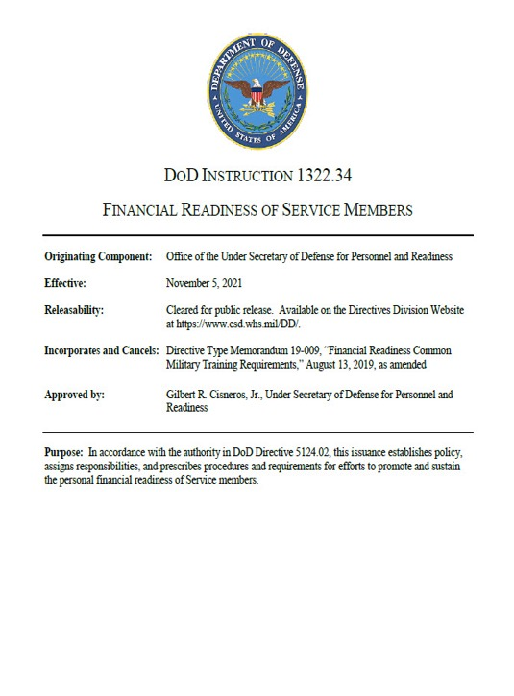
Why Do We Have Touchpoints?
It’s law: Section 992 of Title 10, U.S.C.; FY 16 NDAA
The Military Departments
will provide programs and resources addressing the financial decisions facing Service members, and the effects such decisions can have on their personal and professional lives.

Slide 6
Terminal Learning Objective (TLO) Matrix
 |  | Initial Entry Training | First Duty Station | Permanent Change of Station | Promotion | Vesting in TSP | Entitlement to Continuation Pay | Major Life Events | Leadership Training | Pre- and Post- Deployment | Transition
Basic Finance | Recognize the importance of personal financial management and what resources are available. | X |  |  |  |  |  |  | X
 | Identify warning signs of Service members at risk for financial problems. | X |  |  |  |  |  |  | X | X
 | Understand the fundamentals of banking services and fees. | X | X
 | Understand the fundamentals of creating and managing a spending plan, and the importance of updating a spending plan. |  | X | X | X |  | X | X |  | X | X
 | Understand the fundamentals and management of debt and credit. | X | X | X |  |  |  |  |  | X | X
 | Understand fundamentals of income tax and common tax benefits, and potential changes to tax situation. |  | X |  |  |  | X | X |  | X | X
Consumer Protections | Know military consumer protection law fundamentals, including Service members’ Civil Relief Act and Military Lending Act. | X | X | X |  |  |  |  | X | X
 | Recognize and understand how to protect yourself from misleading consumer practices, and report complaints. |  | X |  |  |  | X |  |  | X
 | Understand how to access credit protection benefits available to Service members. |  | X |  |  |  |  |  |  | X
 | Recognize and identify steps to resolve identity theft. |  | X |  |  |  |  |  |  | X
Planning for the Future | Comprehend the components of Service member’s military retirement system and the importance of preparing for retirement. | X |  |  |  | X | X | X | X |  | X
 | Discuss the reasons, needs, types, and options for purchasing insurance. |  | X |  |  |  |  | X |  | X | X
 | Understand purpose and implications of estate planning (e.g., beneficiaries, wills, trusts, power of attorney). | X |  |  |  |  |  | X |  | X | X

Slide 7
Terminal Learning Objective (TLO) Matrix
Notes:
Permanent Change of Station applies to Service members in paygrades E-1 to E-4 and O-1 to O-3. Promotion applies to Service members in paygrades E-1 to E-5 and O-1 to O-4 Major Life Events includes, at a minimum, marriage, birth of first child, divorce, and disabling sickness or condition. Transition includes separation, transition between Active and Reserve Components, and retirement.
 |  | Initial Entry Training | First Duty Station | Permanent Change of Station | Promotion | Vesting in TSP | Entitlement to Continuation Pay | Major Life Events | Leadership Training | Pre- and Post- Deployment | Transition
Compensation, Benefits, and Entitlements | Know the components of basic pay and allowances throughout one’s military career. | X
 | Examine the impact of special pay and entitlements. |  | X | X |  |  |  |  |  | X
 | Discuss TRICARE options and costs. |  | X |  |  |  |  | X |  | X | X
 | Discuss survivor and dependent benefits, including Survivor Benefit Plan and Service members’ Group Life Insurance. |  |  |  |  |  |  | X |  | X | X
 | Understand future financial benefits afforded by the Department’s career investment programs. |  | X |  | X |  |  |  | X
Saving and Investing | Understand interest and how the concept of compounding works. |  | X
 | Recognize the importance of and be able to develop savings and an emergency fund. |  | X |  | X |  |  | X |  | X | X
 | Describe the fundamentals of investing. |  | X
 | Understand and be able to manage a TSP account. |  | X |  | X | X |  |  |  | X | X
Major Purchases | Analyze the implications and identify strategies for financing a major purchase. | X | X
 | Analyze financial implications and identify strategies for buying a car. |  | X
 | Understand education financing, to include available benefits, obligations, and repayment options. |  | X |  |  |  |  | X

Slide 8
Training Completion Options
One on One
  Checklist and handouts
Classroom
  Checklists and handouts
  PowerPoint (PPT) Training Slides and
  Instructor Guide (IG)
  Videos and Video Discussion Guides (VDG)
Online Training
  USCG OWL: https://cg-owl.uscg.mil/moodle/

Slide 9
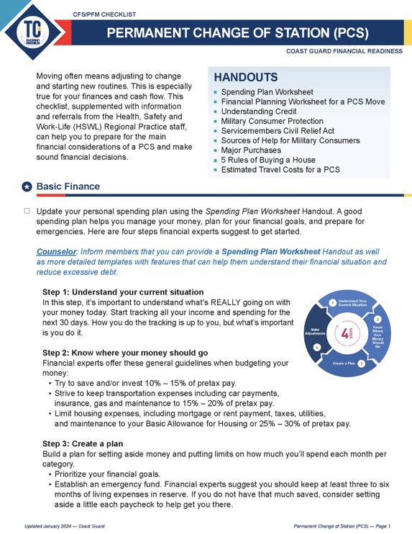
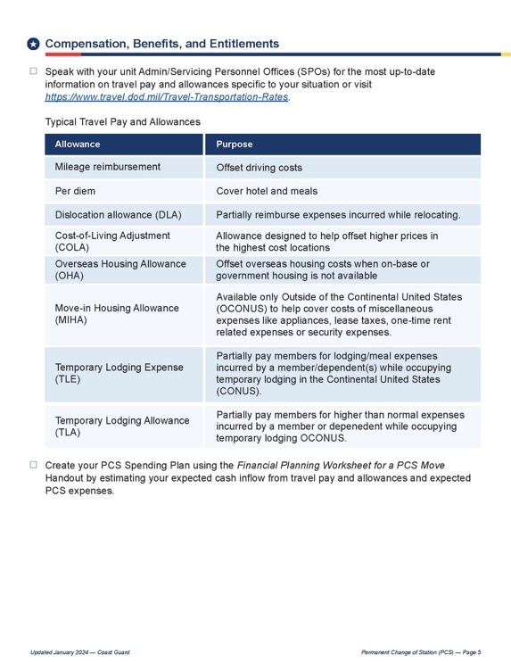
One on One: Touchpoint Checklists and Handouts
TC 3 Permanent Change of Station (PCS) Member Checklist

Slide 10

Classroom Instruction: PowerPoint and Instructor Guide

Slide 11
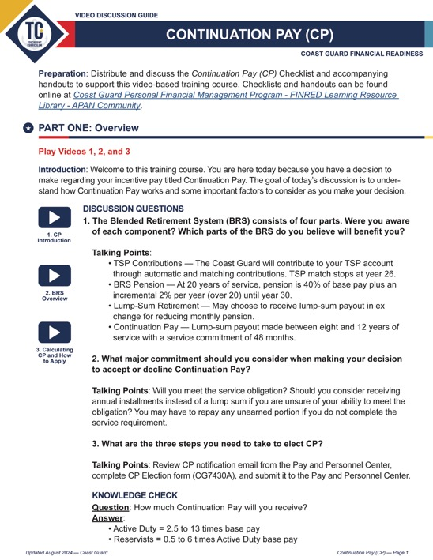
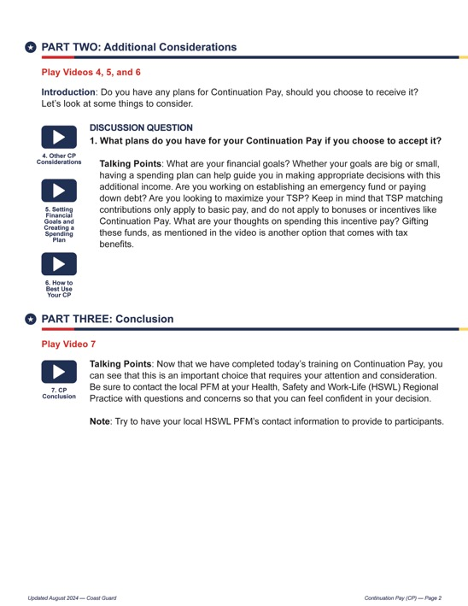
Classroom Instruction: Video and Video Discussion Guides
https://vimeo.com/showcase/10747259 -
Entitlement to Continuation Pay – 7 videos
TC 6 Continuation Pay Video Discussion Guide

Slide 12
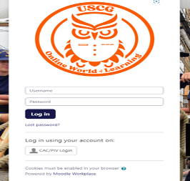


CG Online World of Learning (OWL)
Navigate to the login page at:
Coast Guard Online World of Learning (uscg.mil)
The user lands on the homepage.
Click on CAC/PIV Login.
On the navigation bar, click on Courses, then Course Catalog.

Slide 13
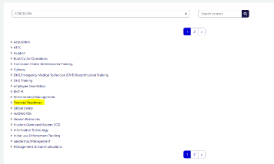
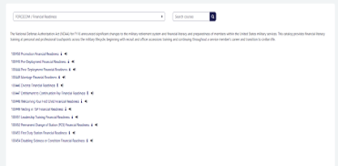
CG Online World of Learning (OWL) Cont.
The Category screen displays. Click on Financial Readiness.
Select the Touchpoint course of your interest.

Slide 14
CG Touchpoint Training Process
Notification
  Coast Guard member is notified by CFS or PFM
  of available Touchpoint Training
Delivery
  CFS or PFM delivers Touchpoint Curriculum
  or refers Coast Guard member to USCG Online World of Learning (OWL).
Completion
  Upon completion, Coast Guard member provides verification of completed training by using the USCG OWL site self-certify option. Member will be directed to input the date of completion and counselor name in the USCG OWL.

Slide 15
Resources
Office of Financial Readiness (FINRED),
CG Resources Page: https://community.apan.org/wg/finred-lrl/m/cg_pfmp
CFS milSuite site: https://milsuite.mil/book/groups/uscg-cfs-resources
USCG Online World of Learning (OWL): https://cg-owl.uscg.mil/moodle/
Spouse Resources: https://www.milspousemoneymission.org

Slide 16
Questions?
The appearance of U.S. Department of Homeland Security (DHS)
visual information does not imply or constitute DHS endorsement.

